Slide 1
COMP208 FINAL REVIEW
EPTS COMP Tutor Shabbir Hussain
Epts.comp@mcgilleus.ca

Slide 2
Useful Links
Course Summary:
http://s3.amazonaws.com/docuum/attachments/2086/comp%20208%20info.pdf?1240285685
Run C code online:
http://codepad.org/
http://www.tutorialspoint.com/compile_c_online.php
Run Fortran code online:
http://www.tutorialspoint.com/compile_fortran_online.php
Run “Matlab” code online:
http://octave-online.net/

Slide 3
Study Strategies
Do past finals
Check the course website
Start by doing the hardest questions first
Test your code on the computer
Make a cheat sheet (as an exercise)

Slide 4
Contents
Pointers
Trick Questions
Big O
Sorting
Recursion
Numerical Methods

Slide 5
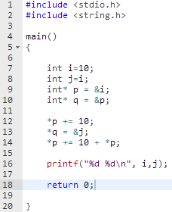
Pointers Example
What will be printed if we run this program?
Solve this problem as if you’re executing the code like a computer
Disclaimer: the techniques shown are not necessarily how the computer does it, but how you should do it on an exam
Notes:
#include <stdio.h>
#include <string.h>
main()
{
int i = 10;
int j = i;
int* p = &i;
int* q = &p;
*p += 10;
*q = &j;
*p += 10 + *p;
printf("%d %d\n", i ,j);
return 0;
}

Slide 6
Pointers Example
line 1 to 10 is just declarations.
Run till line 10 and build a table of variables:
Name | Value | Addr
i | 10 | &i
j | 10 | &j
p | &i | &p
q | &p | &q

Slide 7

Pointers Example
Line 12 is the first line that edits a value
Anytime you see a dereference. Check the table and substitute the name of the correct variable.
Name | Value | Addr
i | 10 | &i
j | 10 | &j
p | &i | &p
q | &p | &q

Slide 8
Pointers Example
Now update the value in the table
Name | Value | Addr
i | 20 | &i
j | 10 | &j
p | &i | &p
q | &p | &q

Slide 9
Pointers Example
Move to the next Line and do the same procedure:
Substitute with correct name
update value
Name | Value | Addr
i | 20 | &i
j | 10 | &j
p | &j | &p
q | &p | &q

Slide 10

Pointers Example
Move to the next Line and do the same procedure:
Substitute with correct name
update value
Name | Value | Addr
i | 20 | &i
j | 30 | &j
p | &j | &p
q | &p | &q

Slide 11

Pointers Example
The program will now print the values of i and j
Name | Value | Addr
i | 20 | &i
j | 30 | &j
p | &j | &p
q | &p | &q

Slide 12
Pointers more Examples
#include <stdio.h> main() { int a[10]; int *p =a; int i; for(i=0; i<10; i++){ a[i]=10-i; } printf("%d %d %d %d\n",a[3],*p,p[4],*a+5); return 0; }
What is the output of this program?

Slide 13
Pointers more Examples
Build a table after all values are initialized
Name | Value | address
a[0] | 10 | a
a[1] | 9 | a+1
a[2] | 8 | a+2
a[3] | 7 | a+3
a[4] | 6 | a+4
a[5] | 5 | a+5
a[6] | 4 | a+6
a[7] | 3 | a+7
a[8] | 2 | a+8
a[9] | 1 | a+9
p | a | &p
#include <stdio.h> main() { int a[10]; int *p =a; int i; for(i=0; i<10; i++){ a[i]=10-i; } printf("%d %d %d %d\n",a[3],*p,p[4],*a+5); return 0; }

Slide 14
Pointers more Examples
Name | Value | address
a[0] | 10 | a
a[1] | 9 | a+1
a[2] | 8 | a+2
a[3] | 7 | a+3
a[4] | 6 | a+4
a[5] | 5 | a+5
a[6] | 4 | a+6
a[7] | 3 | a+7
a[8] | 2 | a+8
a[9] | 1 | a+9
p | a | &p
//start with the original equation printf("%d %d %d %d\n",a[3],*p,p[4],*a+5); //use table to substitute correct variable name: printf("%d %d %d %d\n",a[3],a[0],a[4],a[0]+5); //use table to substitute correct values printf("%d %d %d %d\n",7,10,6,15)

Slide 15
Trick Questions (Don’t be fooled)
#include <stdio.h> #include <string.h> void abc(float, float, float); main() { float y =2.5; abc(6.5, y, y); printf("%f\n", y); return 0; } void abc(float x, float y, float z){ y = y-1; z = z+x; }
What is the Output of this program?
Hint: answer is on the next slide. Don’t look until you try it!
Taken from Fall 2007 Final

Slide 16

Trick Questions (Don’t be fooled)
#include <stdio.h> #include <string.h> void abc(float, float, float); main() { float y =2.5; abc(6.5, y, y); printf("%f\n", y); return 0; } void abc(float x, float y, float z){ y = y-1; z = z+x; }
Whenever there is a function check the types for the inputs and the outputs to determine if values are modified.
Here inputs are passed by value.
Trick: the value of y does not change

Slide 17
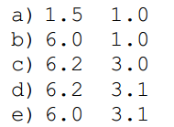
Trick Questions (Don’t be fooled)
program exam
implicit none
integer :: calc
real :: x=1.5, y=1.0
x = calc(y, y)
write(*,*) x, y
end program exam
integer function calc(a, b)
implicit none
real::a, b
b = b + 2.1
calc = a + b
END function calc
What is the Output of this Program?
Taken from Fall 2013Final

Slide 18
Trick Questions (Don’t be fooled)
program exam
implicit none
integer :: calc
real :: x=1.5, y=1.0
x = calc(y, y)
write(*,*) x, y
end program exam
integer function calc(a, b)
implicit none
real::a, b
b = b + 2.1
calc = a + b
END function calc
What is the Output of this Program?
Fortran uses pass by reference in which case when b =b+2.1 then y =3.1 and so a=3.1 and so calc returns 6 (since calc returns an integer) that's why when you print the answer x = 6.0 , y=3.1
Taken from Fall 2013Final

Slide 19
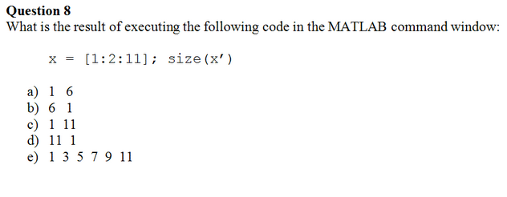
Trick Questions (Don’t be fooled)
Taken from Fall 2014Final

Slide 20
Trick Questions (Don’t be fooled)
Taken from Fall 2014Final

Slide 21
Trick Questions (Don’t be fooled)
General Solution to these types of problems:
Know your stuff
Relax, its not worth that much anyway

Slide 22
Big O
How does the Upper bound complexity grow?
Its a measure of either run-time or resources (memory slots, etc.)

Slide 23
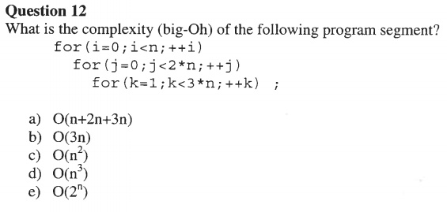
Big O
Taken from fall 2006 final

Slide 24
Big O
n
2n
3n-1
n*(2n)*(3n-1)
= 2n^2*(3n-1)
= 6n^3 - 2n^2
Take the highest order
Taken from fall 2006 final

Slide 25
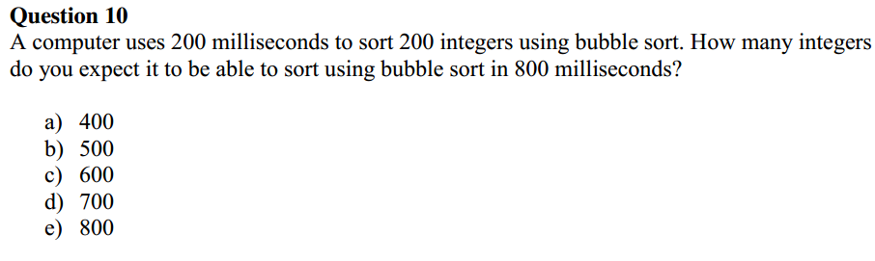
Big O

Slide 26
Big O
This question involves knowing that bubble sort is of time complexity O(n^2). This means that as you have more values to sort, the amount of time to sort them grows proportionally to the square of the amount of values. Use the following ratio so solve for N.
200^2/N^2 = 200/800
N=400

Slide 27
Binary Searching
1.Take a sorted array A and set two indeces left and right where left is the lowest value and right is the highest value
2. if left is greater than or equal to right then RETURN with no results
3. calculate a mid index using mid=(left+right)/2
4. check if A[mid] is the value you are looking for RETURN A[mid]
5. otherwise if A[mid] is less than your value set left = mid (search the upper half) else set right=mid (search the lower half
6. Return to step 2

Slide 28
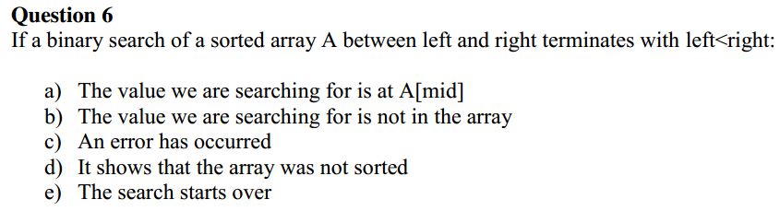
Binary Searching

Slide 29
Binary Searching
Looking at the plain English definition, the only way to exit this program and still have left index less than right index is if step 4 occurs.

Slide 30



Sorting Algorithms in Plain English
One pass of Bubble sort:
Start at the back
Swap if that element is less than the preceding
Move to the next element (continue till first element)

Slide 31

Sorting Algorithms in Plain English
One pass of Selection sort:
Find the smallest element
Swap it with the front

Slide 32
Sorting Algorithms in Plain English
One pass of Selection sort:
Find the smallest element
Swap it with the front
What would the array look like after a second pass?

Slide 33

Sorting Algorithms in Plain English
One pass of Selection sort:
Find the smallest element
Swap it with the front
What would the array look like after a second pass?

Slide 34

Sorting Algorithms in Plain English
0 pass:
One pass of Insertion sort:
Take an element from the rest of the list
Insert it to the sorted list
1st pass:
2nd pass:

Slide 35
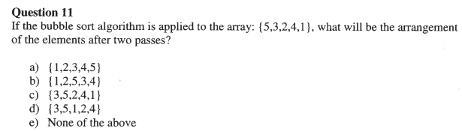
Sorting Pop Quiz
Taken from 2006 Fall Final

Slide 36


Sorting Pop Quiz
1st Pass:
Taken from 2006 Fall Final
2nd Pass:

Slide 37
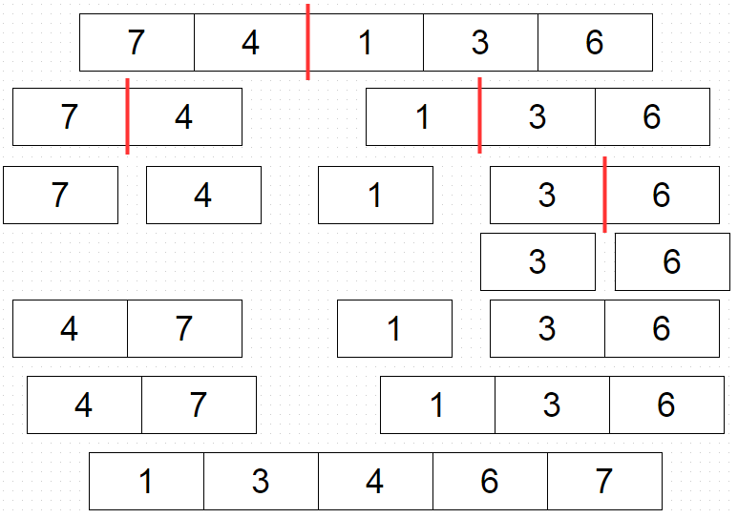
Sorting Algorithms in Plain English
Merge sort:
If list has only one element you are done
otherwise separate it into two lists
merge sort on first half
merge sort on second half
recombine

Slide 38
Recursion
#include <stdio.h> #include <string.h> int f(int x, int n){ if(n<4) return f(x+1,n+1) + f(x+2,n+1); else return x; } main() { printf("%i\n", f(0,0)); return 0; }
What is the output of the following Program?
Hint: expand the function

Slide 39
Recursion
Expand the recurrence relation:
f(x,4) = x
f(x,n)= f(x+1,n+1)+f(x+2,n+1)
f(0,0)
= f(1,1) +f(2,1)
= f(2,2) +f(3,2) + f(3,2) +f(4,2)
= f(3,3) +f(4,3) +f(4,3) +f(5,3) +f(4,3) +f(5,3) +f(5,3) +f(6,3)
=f(4,4)+f(5,4)+f(5,4)+f(6,4)+f(5,4)+f(6,4)+f(6,4)+f(7,4)+f(5,4)+f(6,4)+f(6,4)+f(7,4)+f(6,4)+f(7,4)+f(7,4)+f(8,4)
= 4 +5 +5 + 6 + 5 + 6 + 6 +7 + 5 +6 +6 +7 +6 +7 +7 +8
=96

Slide 40
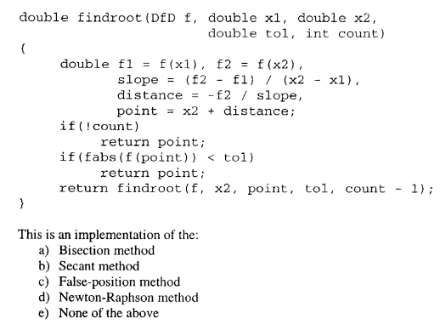
Numerical Methods
Taken from Fall 2005 final

Slide 41
Numerical Methods (root finding)
Passing functions as Arguments
typedef double (*DfD) (double); typedef double (*DfDD) (double, double); typedef double (*DfDDD) (double, double, double); double bisection_rf(DfD f, double x0, double x1, double tol);
f is of type DFD which is a function that takes a double as input and returns a double

Slide 42
Numerical Methods
How did I know? Because its the code copied from notes. Read your class notes! More Importantly try to understand the concepts

Slide 43
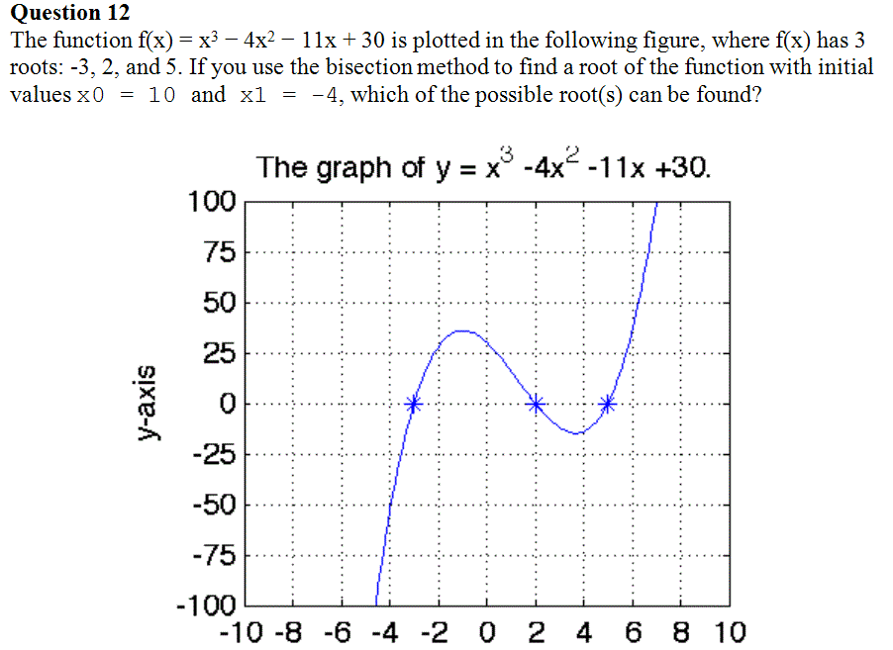
Numerical Methods
Choices:
-3
2
5
None of the above
All the above

Slide 44
Numerical Methods

Slide 45
Numerical Methods

Slide 46
Numerical Methods

Slide 47
Numerical Methods

Slide 48
Numerical Methods

Slide 49
Numerical Methods
The bisection method is guaranteed to fin a root in this interval since we have a continuous function and our two points are above and below zero
Answer: C root at 5

Slide 50
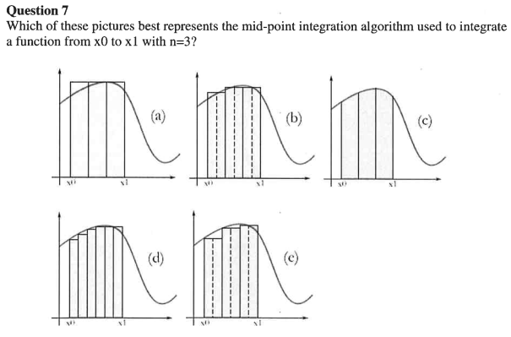
Numerical Methods (Integration)
Taken from winter 2007 final

Slide 51
Numerical Methods (Integration)
Mid point method evaluates the function at the middle of the interval
Taken from winter 2007 final

Slide 52
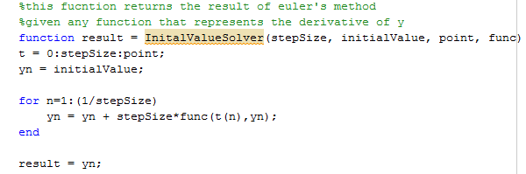
Numerical Methods (IVP)
Which IVP solution does this method implement
Euler
Bisection
False Position
Runge-Kuttaa

Slide 53
Numerical Methods (IVP)
Which IVP solution does this method implement
Euler
Bisection
False Position
Runge-Kuttaa

Slide 54
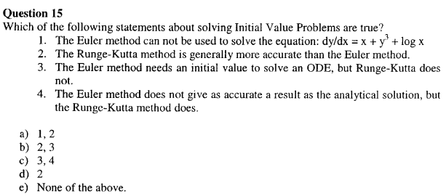
Numerical Methods (IVP)
Taken from Fall 2005 final

Slide 55
Numerical Methods (IVP)
false, Euler method is used for any first order ODE
true, euler method needs a smaller step size to achieve the same accuracy
false, these are all methods for solving initial value problems
false, All numerical methods have some error

Slide 56
Numerical Methods
Is there a trick to do these types of problems?
Yes. Memorize all the algorithms

Slide 57
Good Luck!

